Slide 1



Microsoft Fabric
Sessão 5 Praticando Análise de Dados e extraindo valor do data lake Data Science no Fabric
Armando Lacerda
Azure Cloud Architect Independent Consultant
Tiago Balabuch
Cloud Solutions Architect
Notes:
Both

Slide 2
Microsoft Fabric
Sessão 5 Sparking Fabric Engenharia de Dados no Microsoft Fabric
Armando Lacerda
Azure Cloud Architect Independent Consultant
Tiago Balabuch
Cloud Solutions Architect
Notes:
Both

Slide 3
Agenda
Apache Spark no Microsoft Fabric
Notebooks and Spark processing
Demos

Slide 4







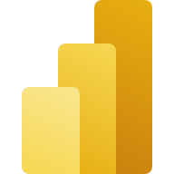
OneLake
Data Factory
Data Warehouse
Data Engineering
Data Science
Real Time Analytics
Data Activator
Power BI

Slide 5
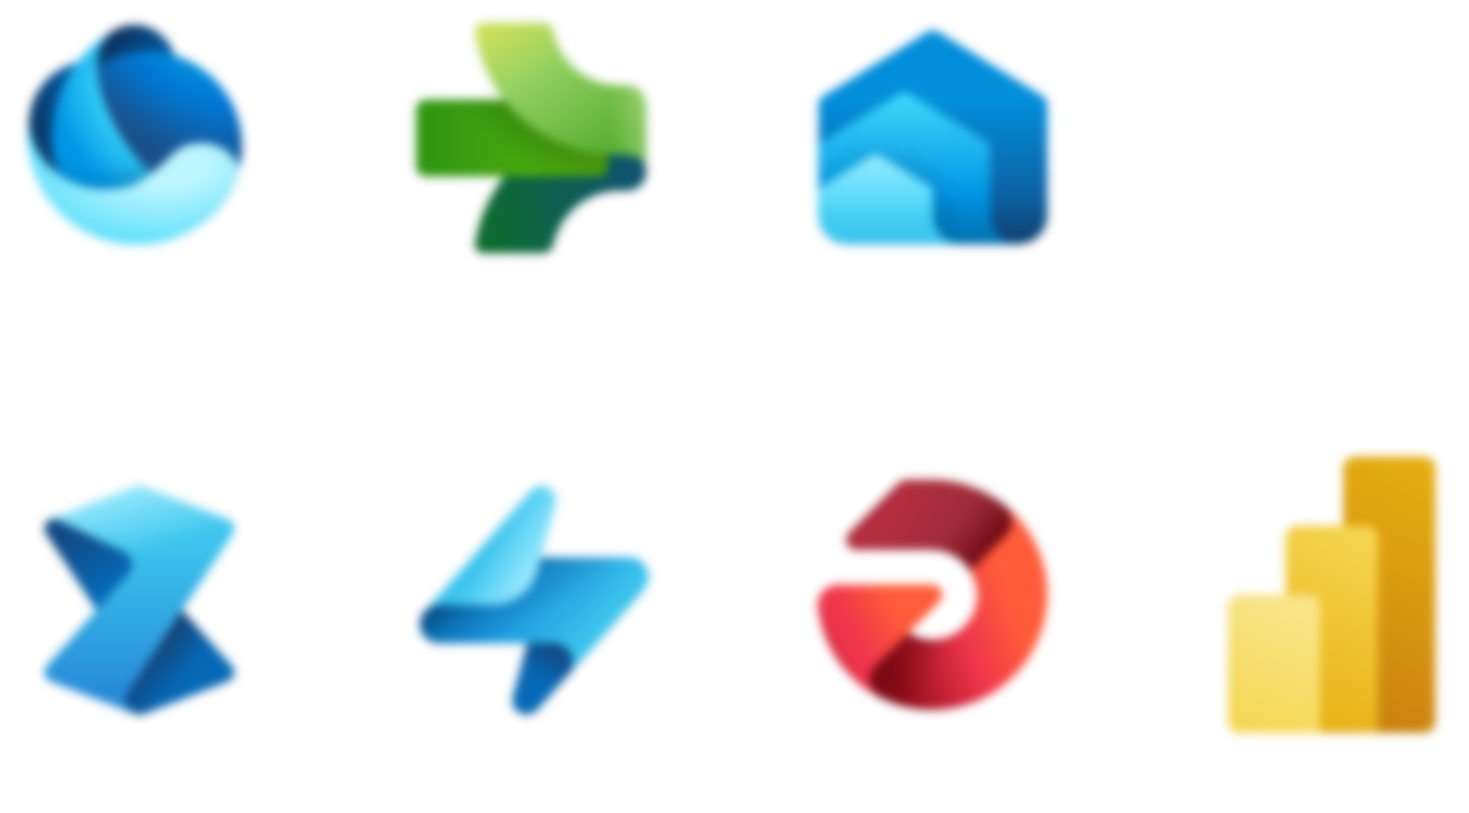
Data Engineering

Slide 6
Data pipelines and movement

Slide 7
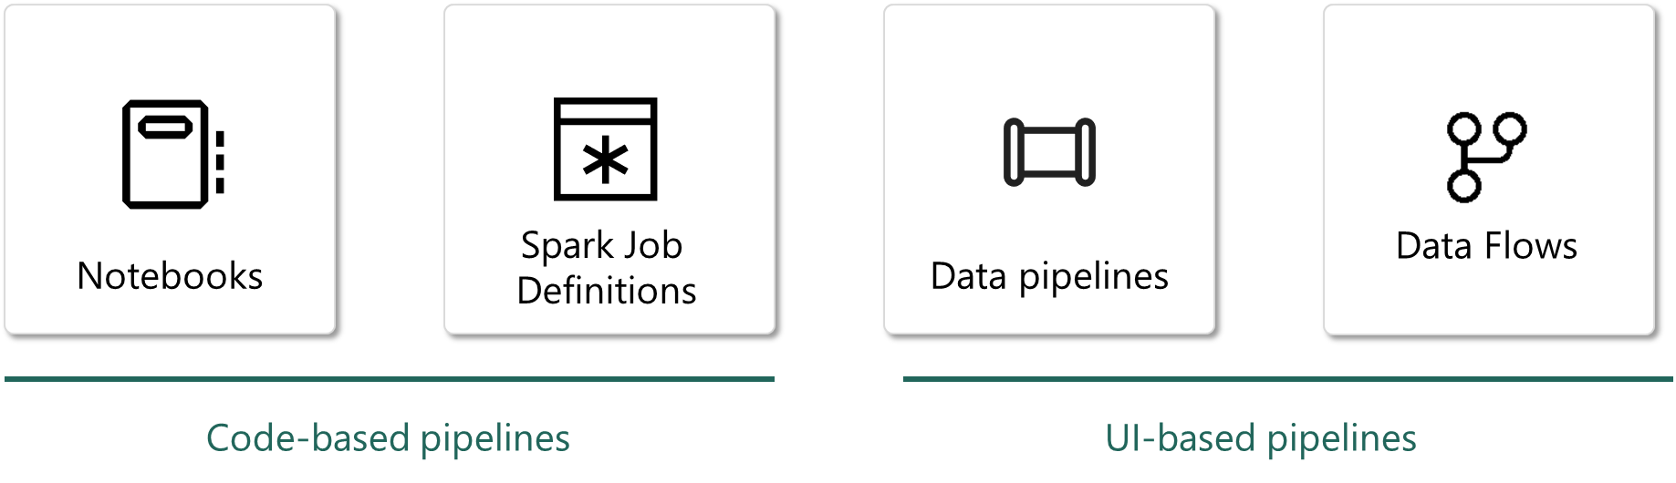
UI-based pipelines

Slide 8
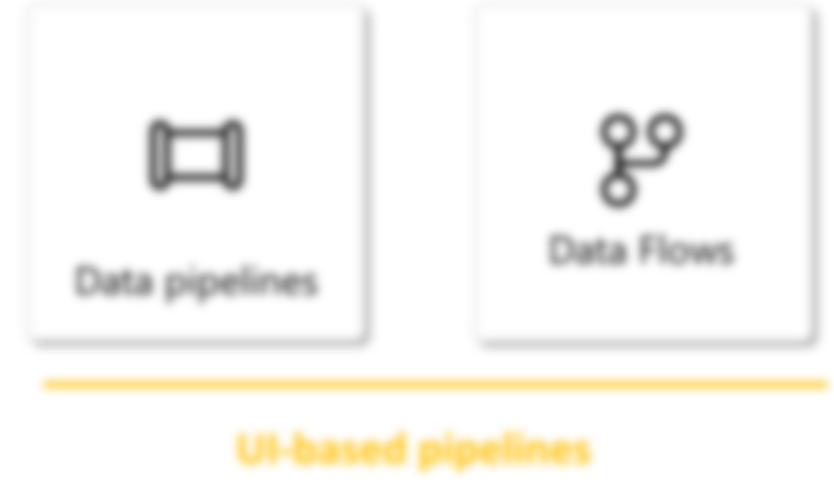
Code-based pipelines

Slide 9
Data pipelines and movement
Data storage and architecture

Slide 10
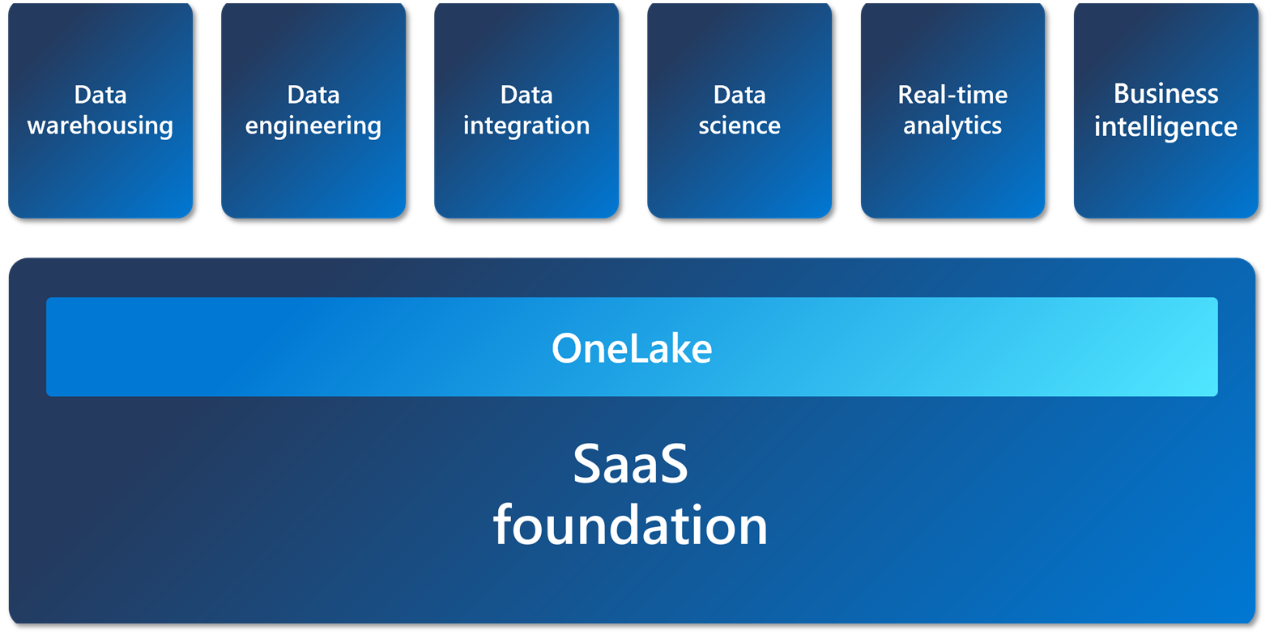

Slide 11
Data pipelines and movement
Data storage and architecture
Delivering data to data analysts and data scientists

Slide 12




Data Engineer
Notebook

Slide 13

Data Engineer
Notebook
Lakehouse

Slide 14

Data Engineer
Notebook
Notebook
Notebook
Data Scientist
Lakehouse

Slide 15
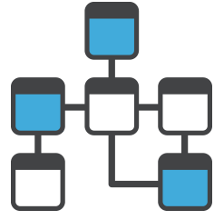
Data Engineer
Notebook
Notebook
Notebook
Data Scientist
Lakehouse

Slide 16
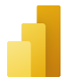

Data Engineer
Notebook
Notebook
Notebook
PowerBI
Data Scientist
Data Analyst
Lakehouse

Slide 17
Demos

Slide 18
Nos vemos na próxima sessão.
Armando Lacerda
Azure Cloud Architect Independent Consultant
Tiago Balabuch
Cloud Solutions Architect
Notes:
Armando and Tiago

